Slide 1
MBS AND ENDSTAGE KIDNEY DISEASE: BRIDGE TO THE TRANSPLANT
Francesco Saverio Papadia, MD, FACS, FEBS (SurgOnc)
Department of Surgical Sciences and Integrated Diagnostics DISC
University of Genoa, Italy

Slide 2
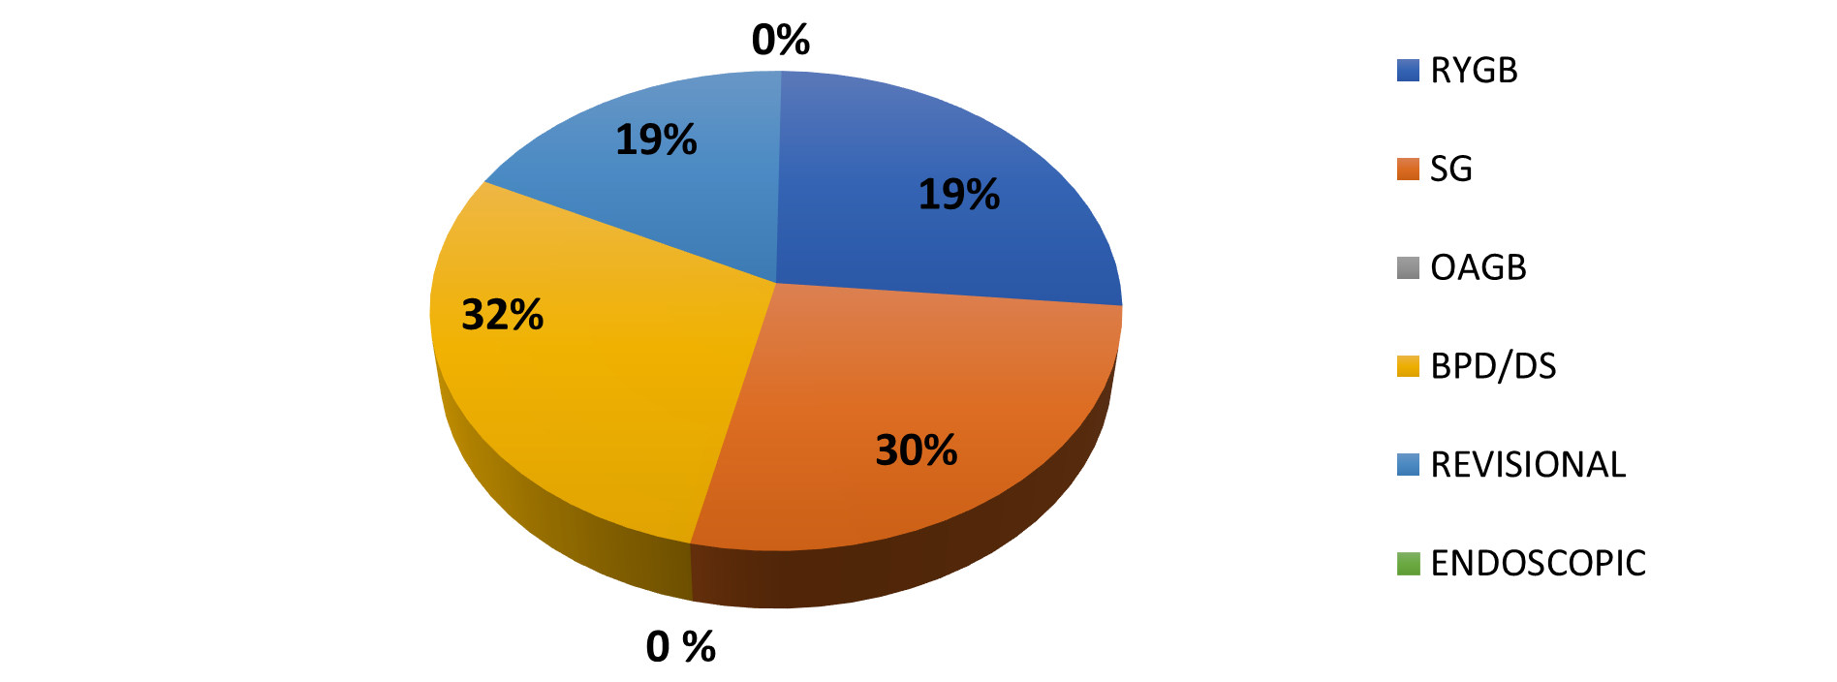
Case mix disclosure
No financial conflict of interest to disclose

Slide 3
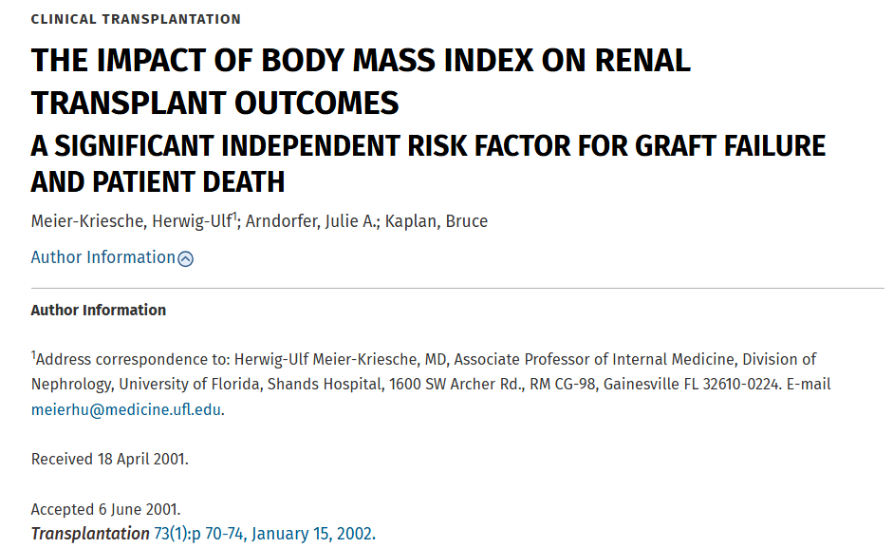

Slide 4
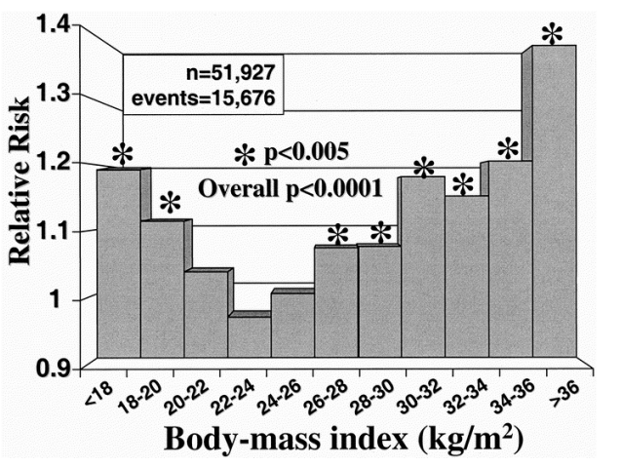
Graft loss

Slide 5
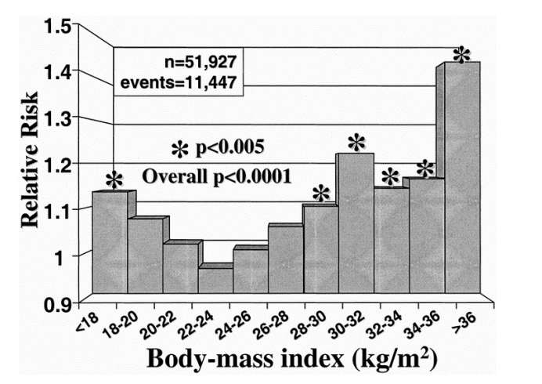
Overall mortality

Slide 6
Obesity and kidney transplant
Bariatric surgery:
BMI 30-35 kg/m² with complications
BMI >35 uncomplicated
Transplant surgery criteria:
Donor < 35 kg/m²
Recipient < 40 kg/m² (preferable, < 35)

Slide 7
Is there a role for MBS in patients with chronic kidney failure?

Slide 8
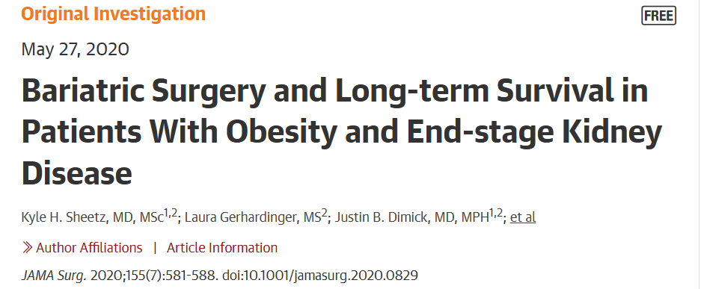

Slide 9
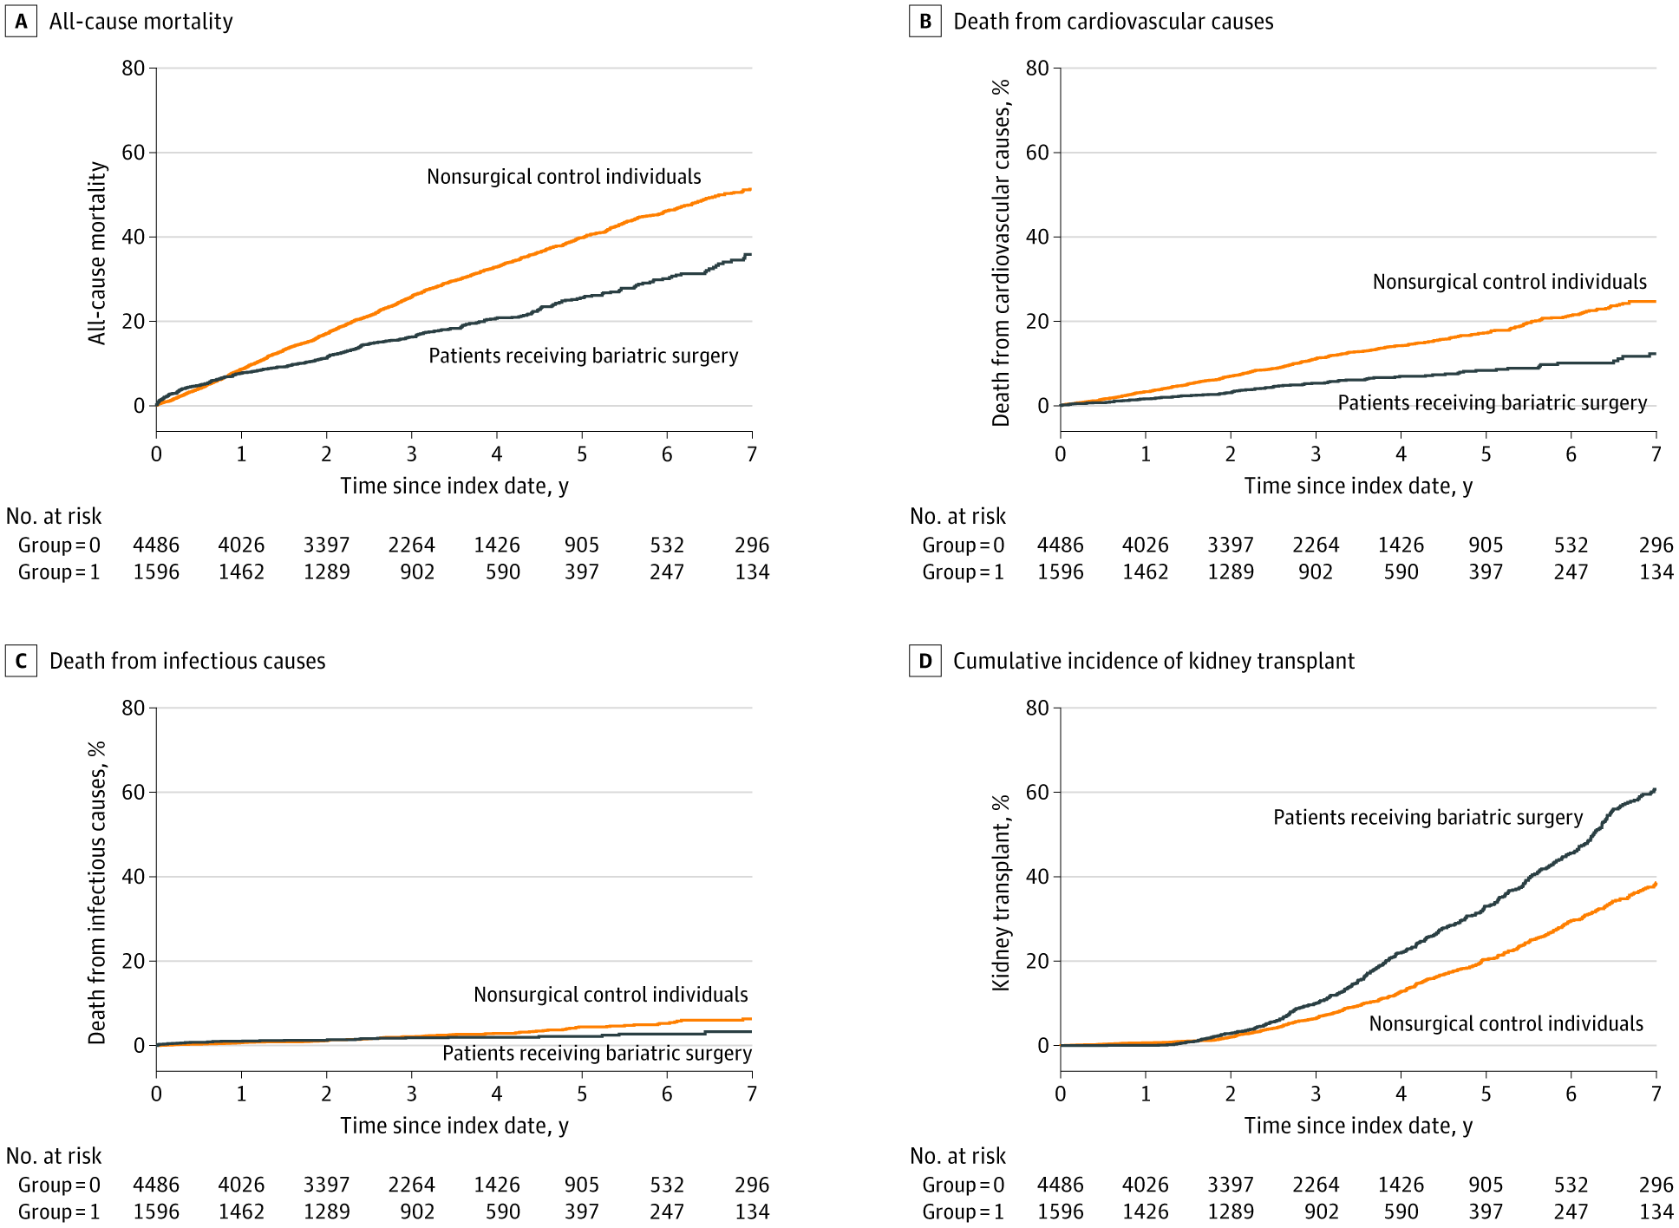

Slide 11
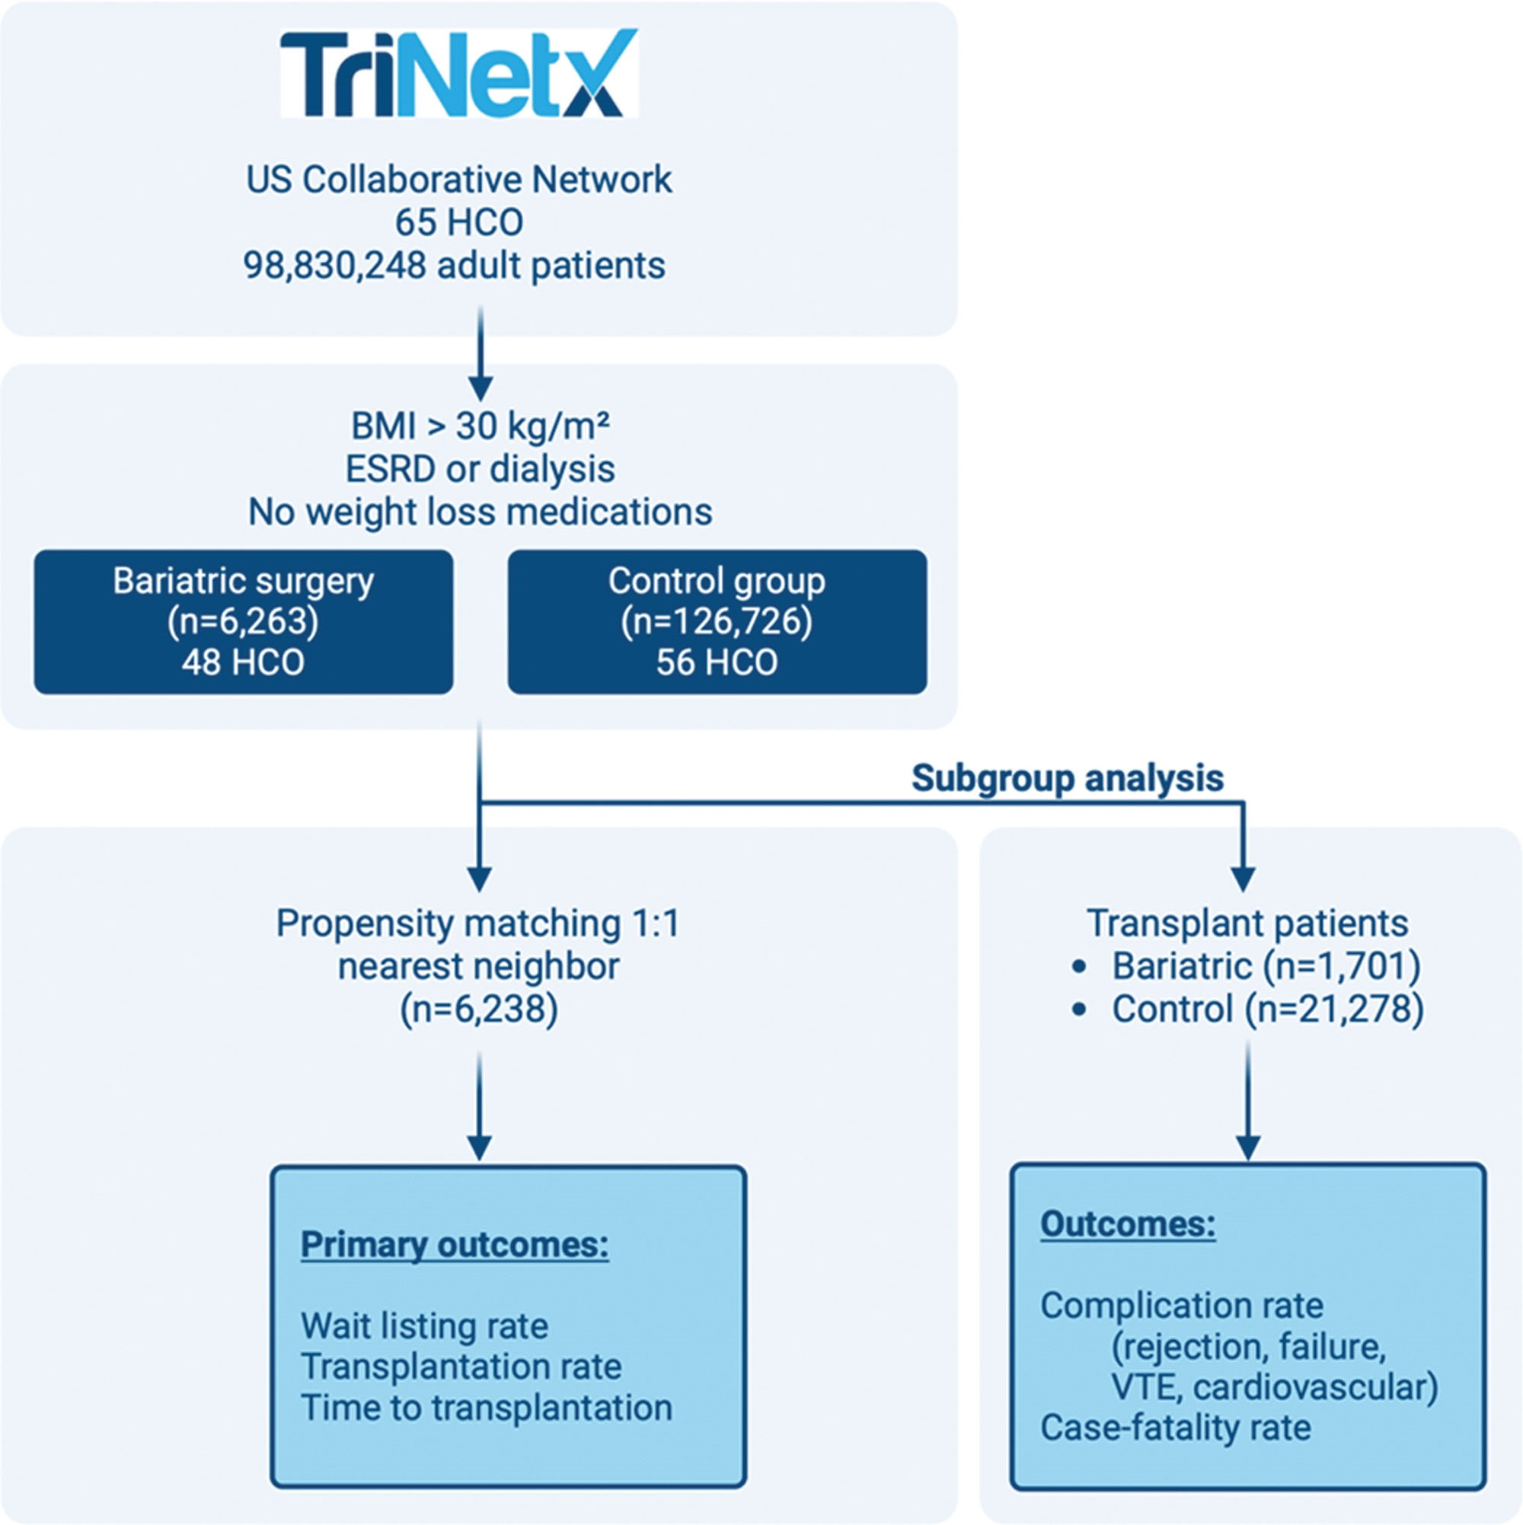
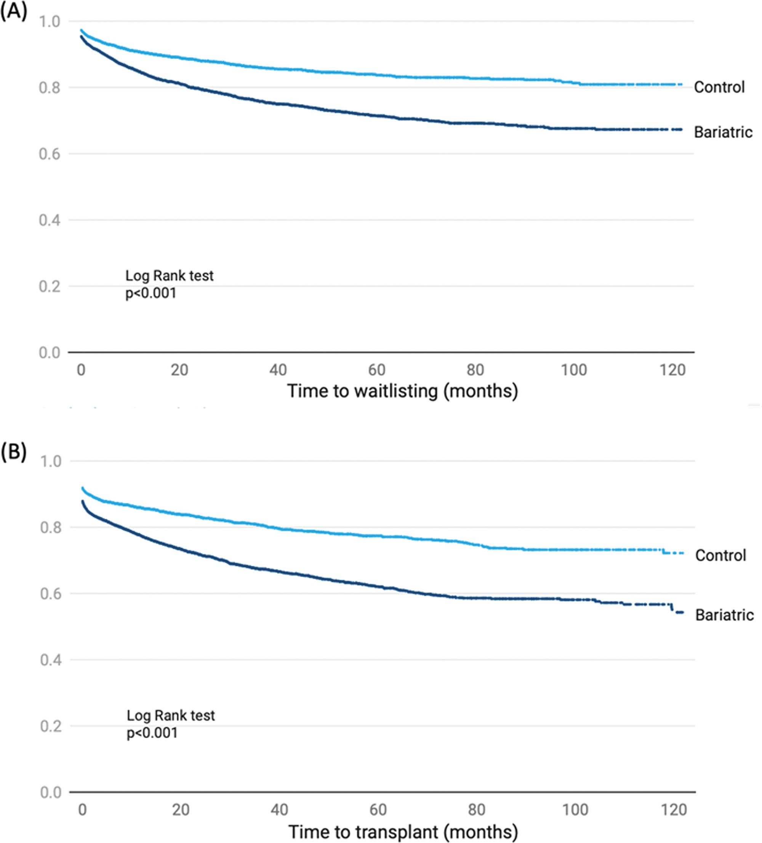

Slide 12
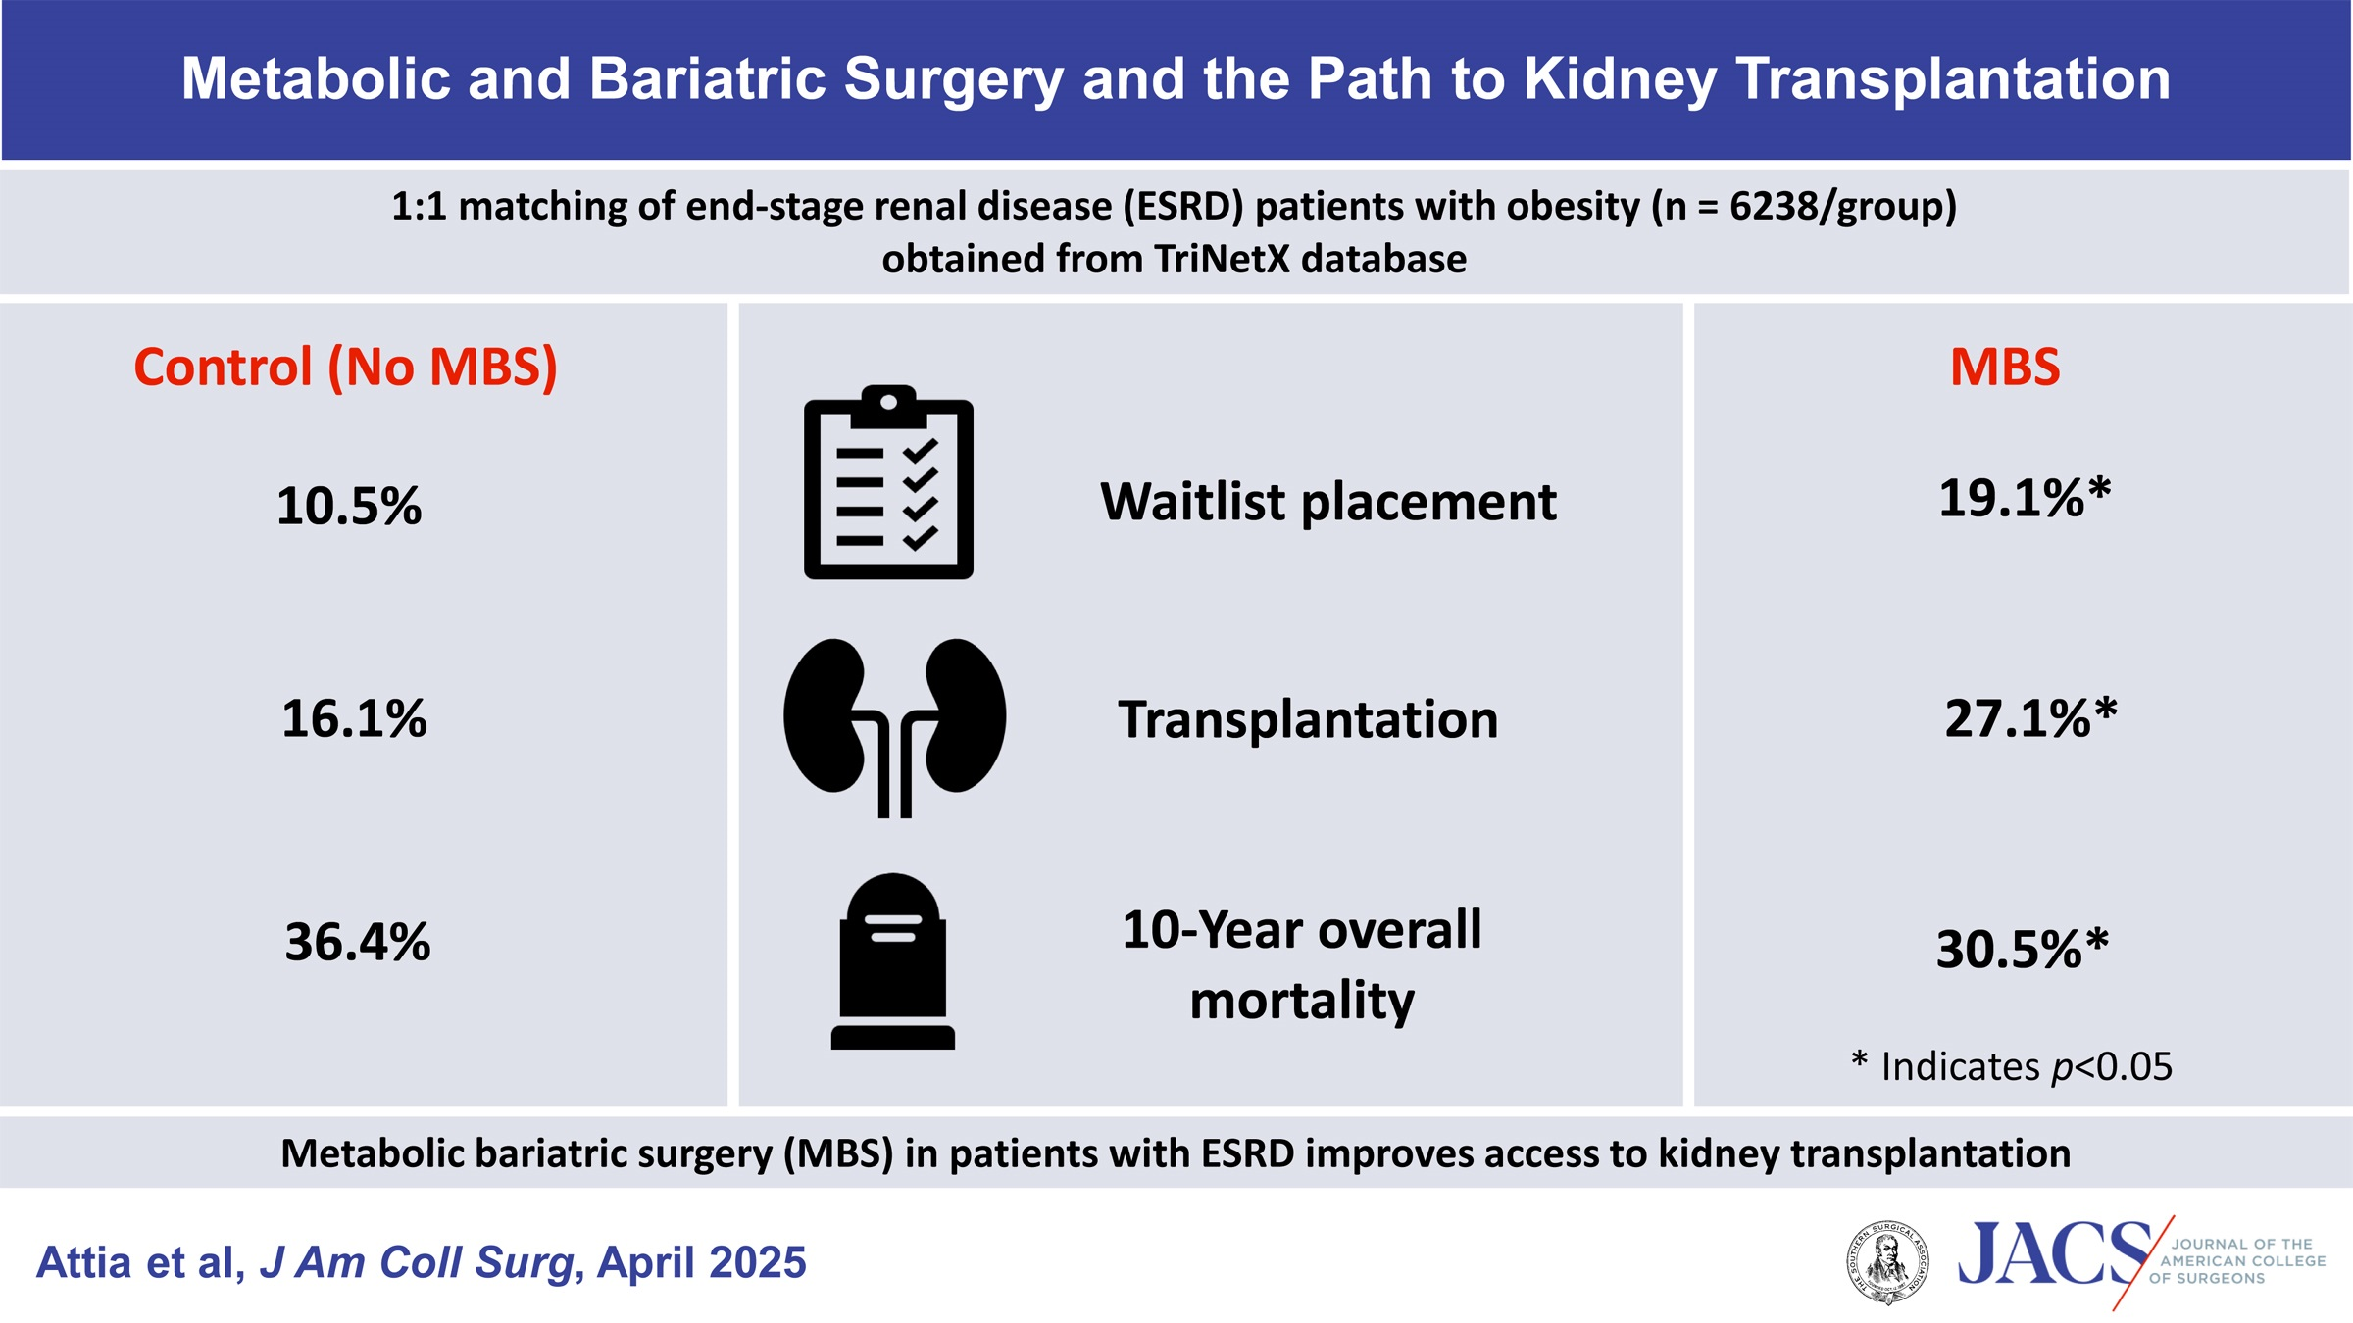

Slide 13
Timing of kidney transplant and MBS

Slide 16
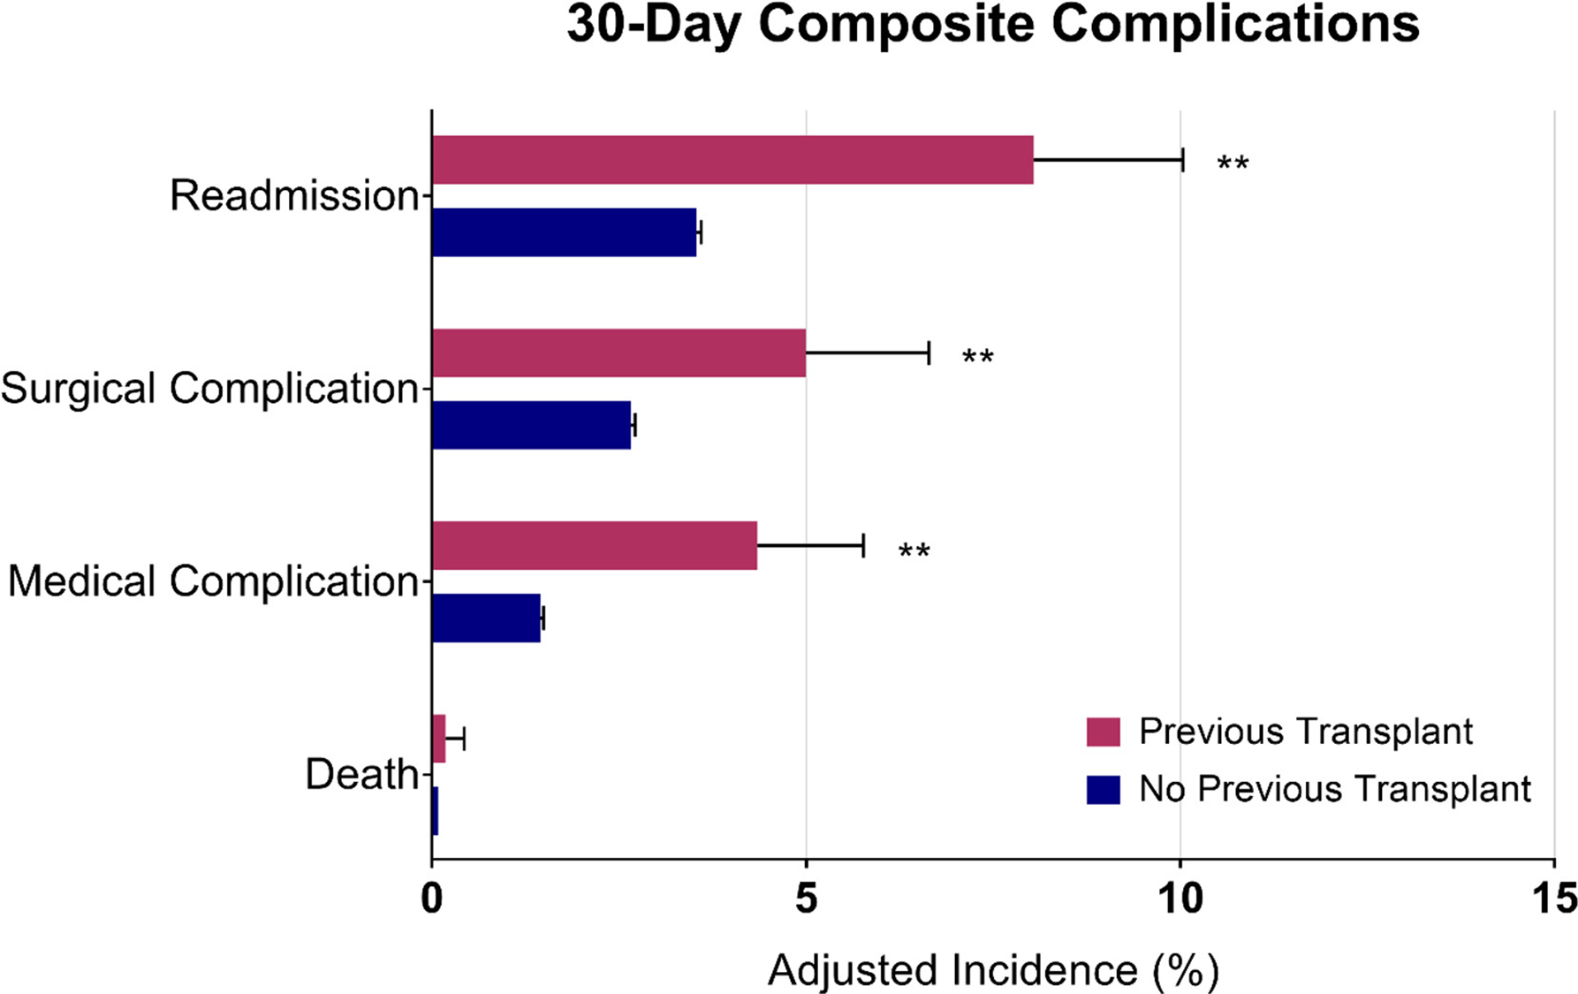

Slide 17
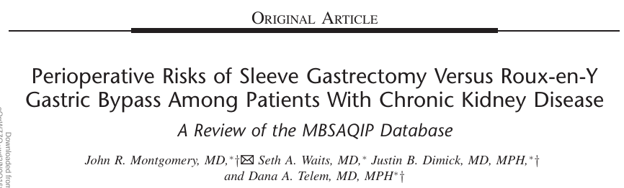
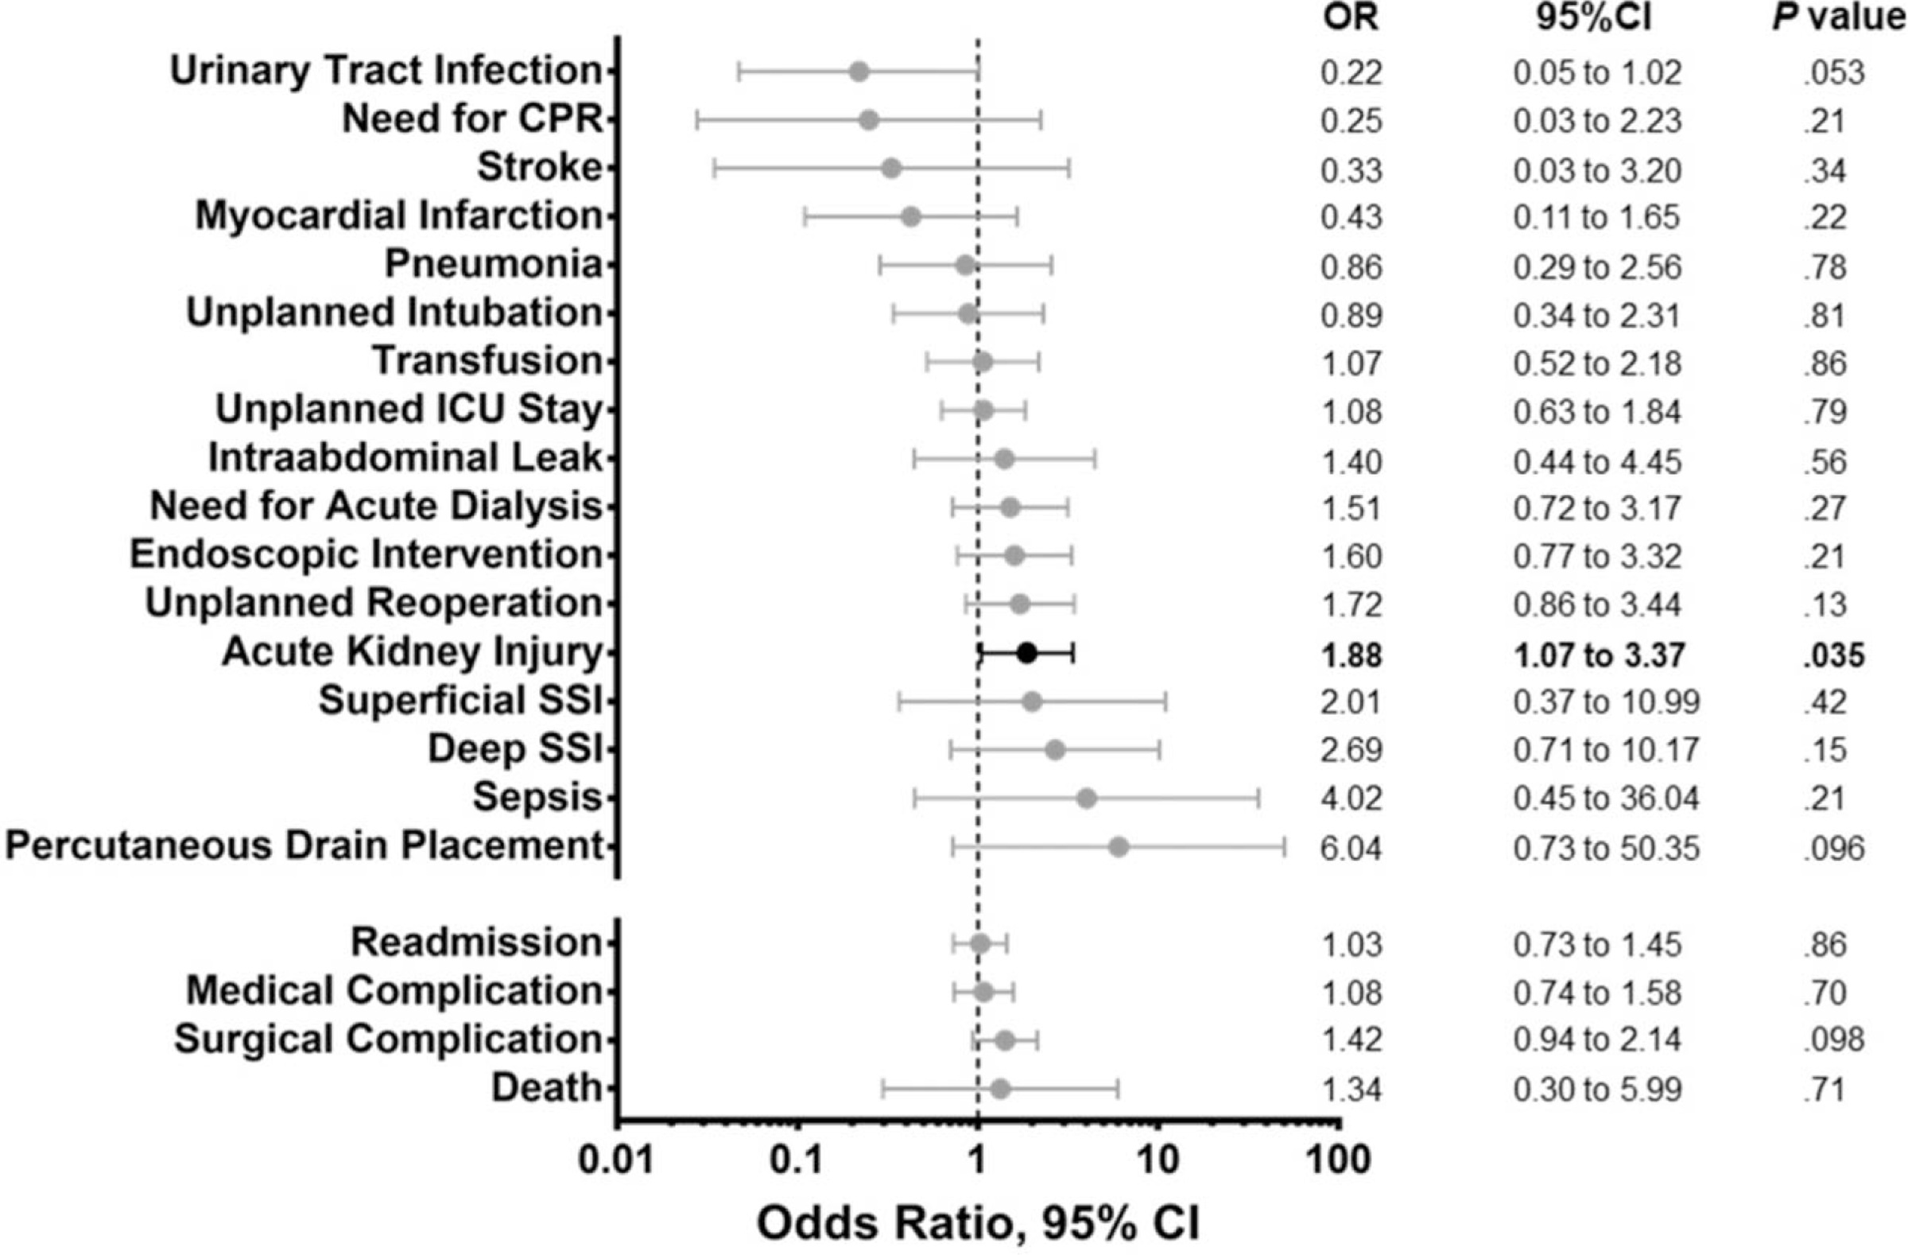

Slide 18
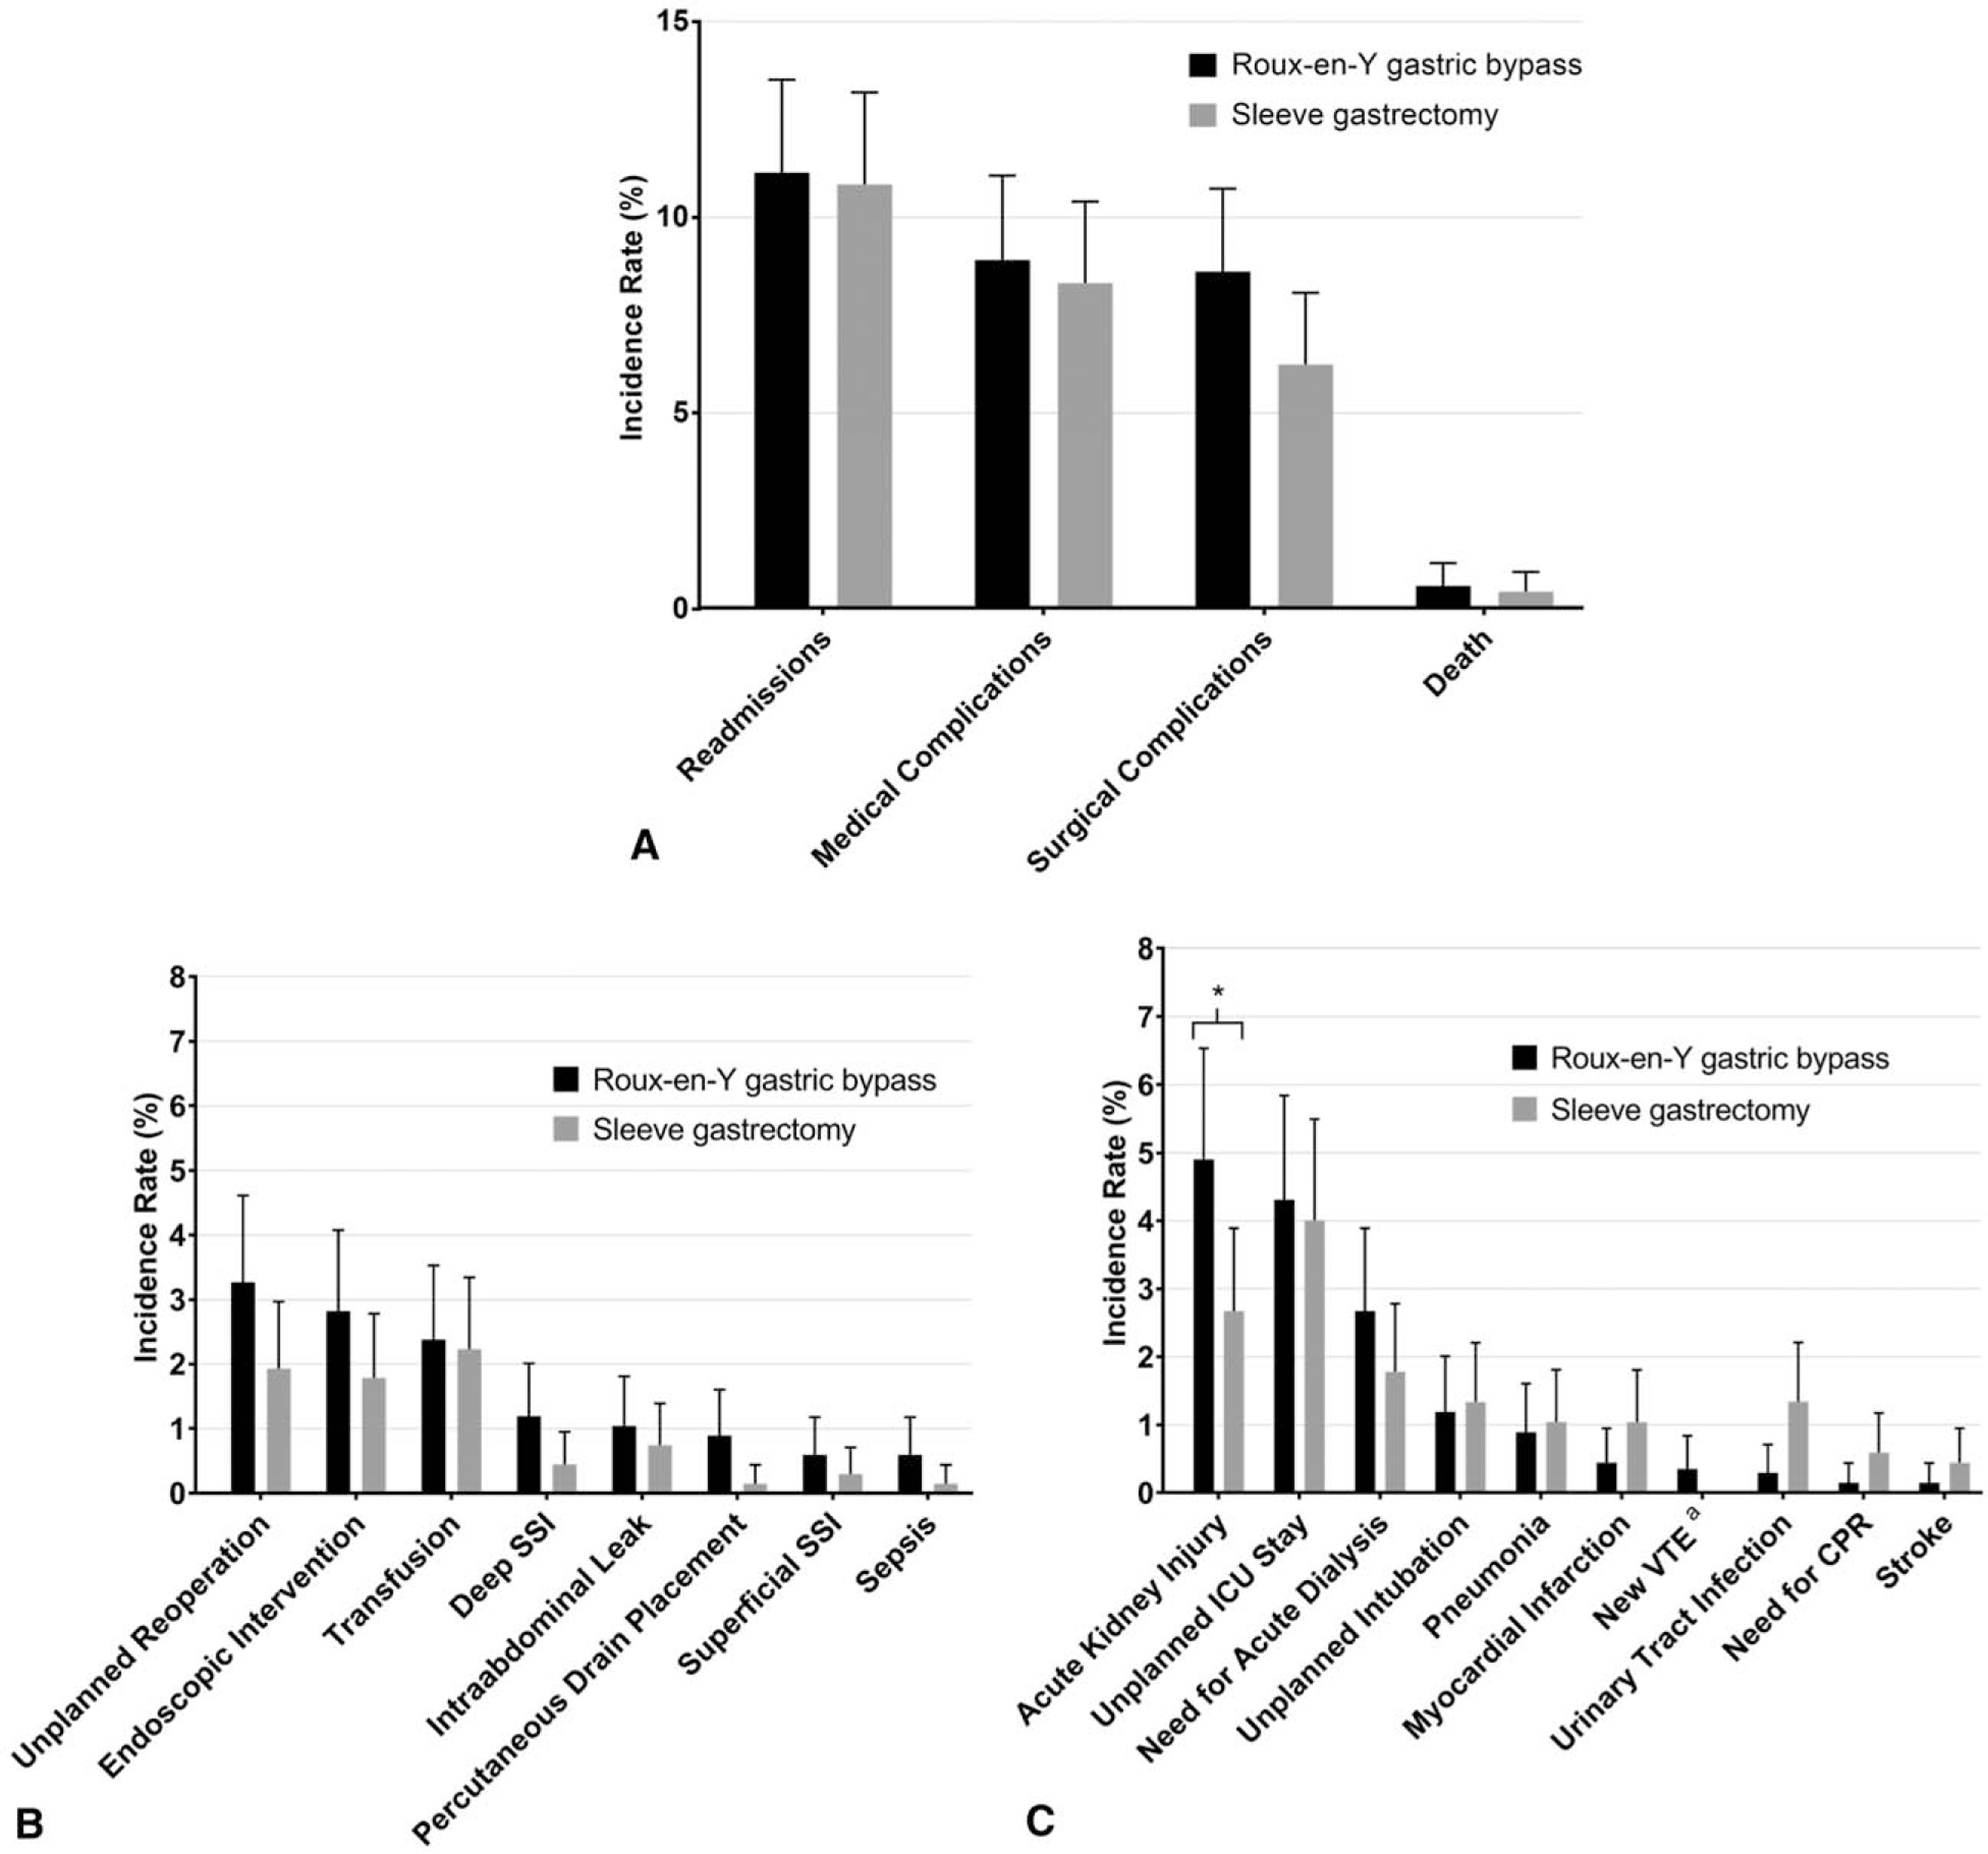

Slide 20
“….Almost half of patients with Roux-en-Y gastric bypass without a history of nephrolithiasis showed hyperoxaluria or hypocitraturia….. This prevalence was significantly higher than in body mass index matched controls. These risk factors were negated by lower urine calcium excretion in patients with Roux-en-Y gastric bypass…”

Slide 21
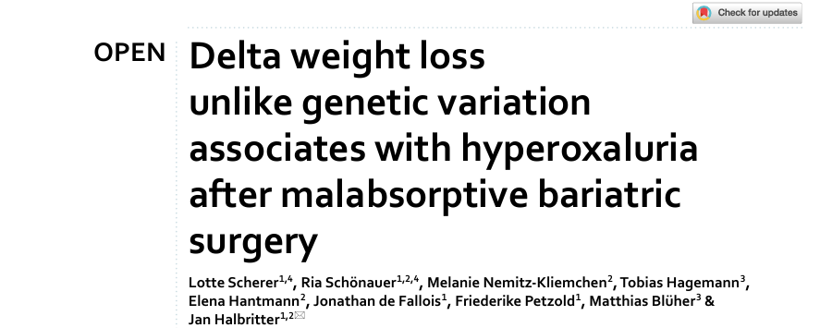
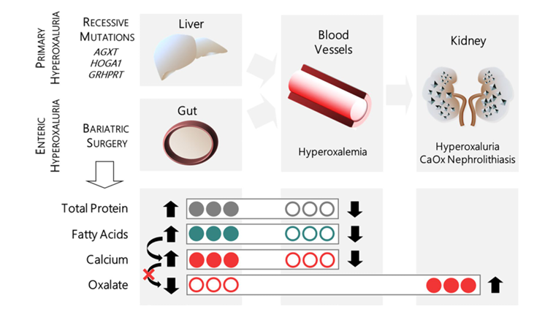

Slide 22
How does MBS compare to OMMs?

Slide 23
Semaglutide/Tirzepatide 16,8%)

Slide 25
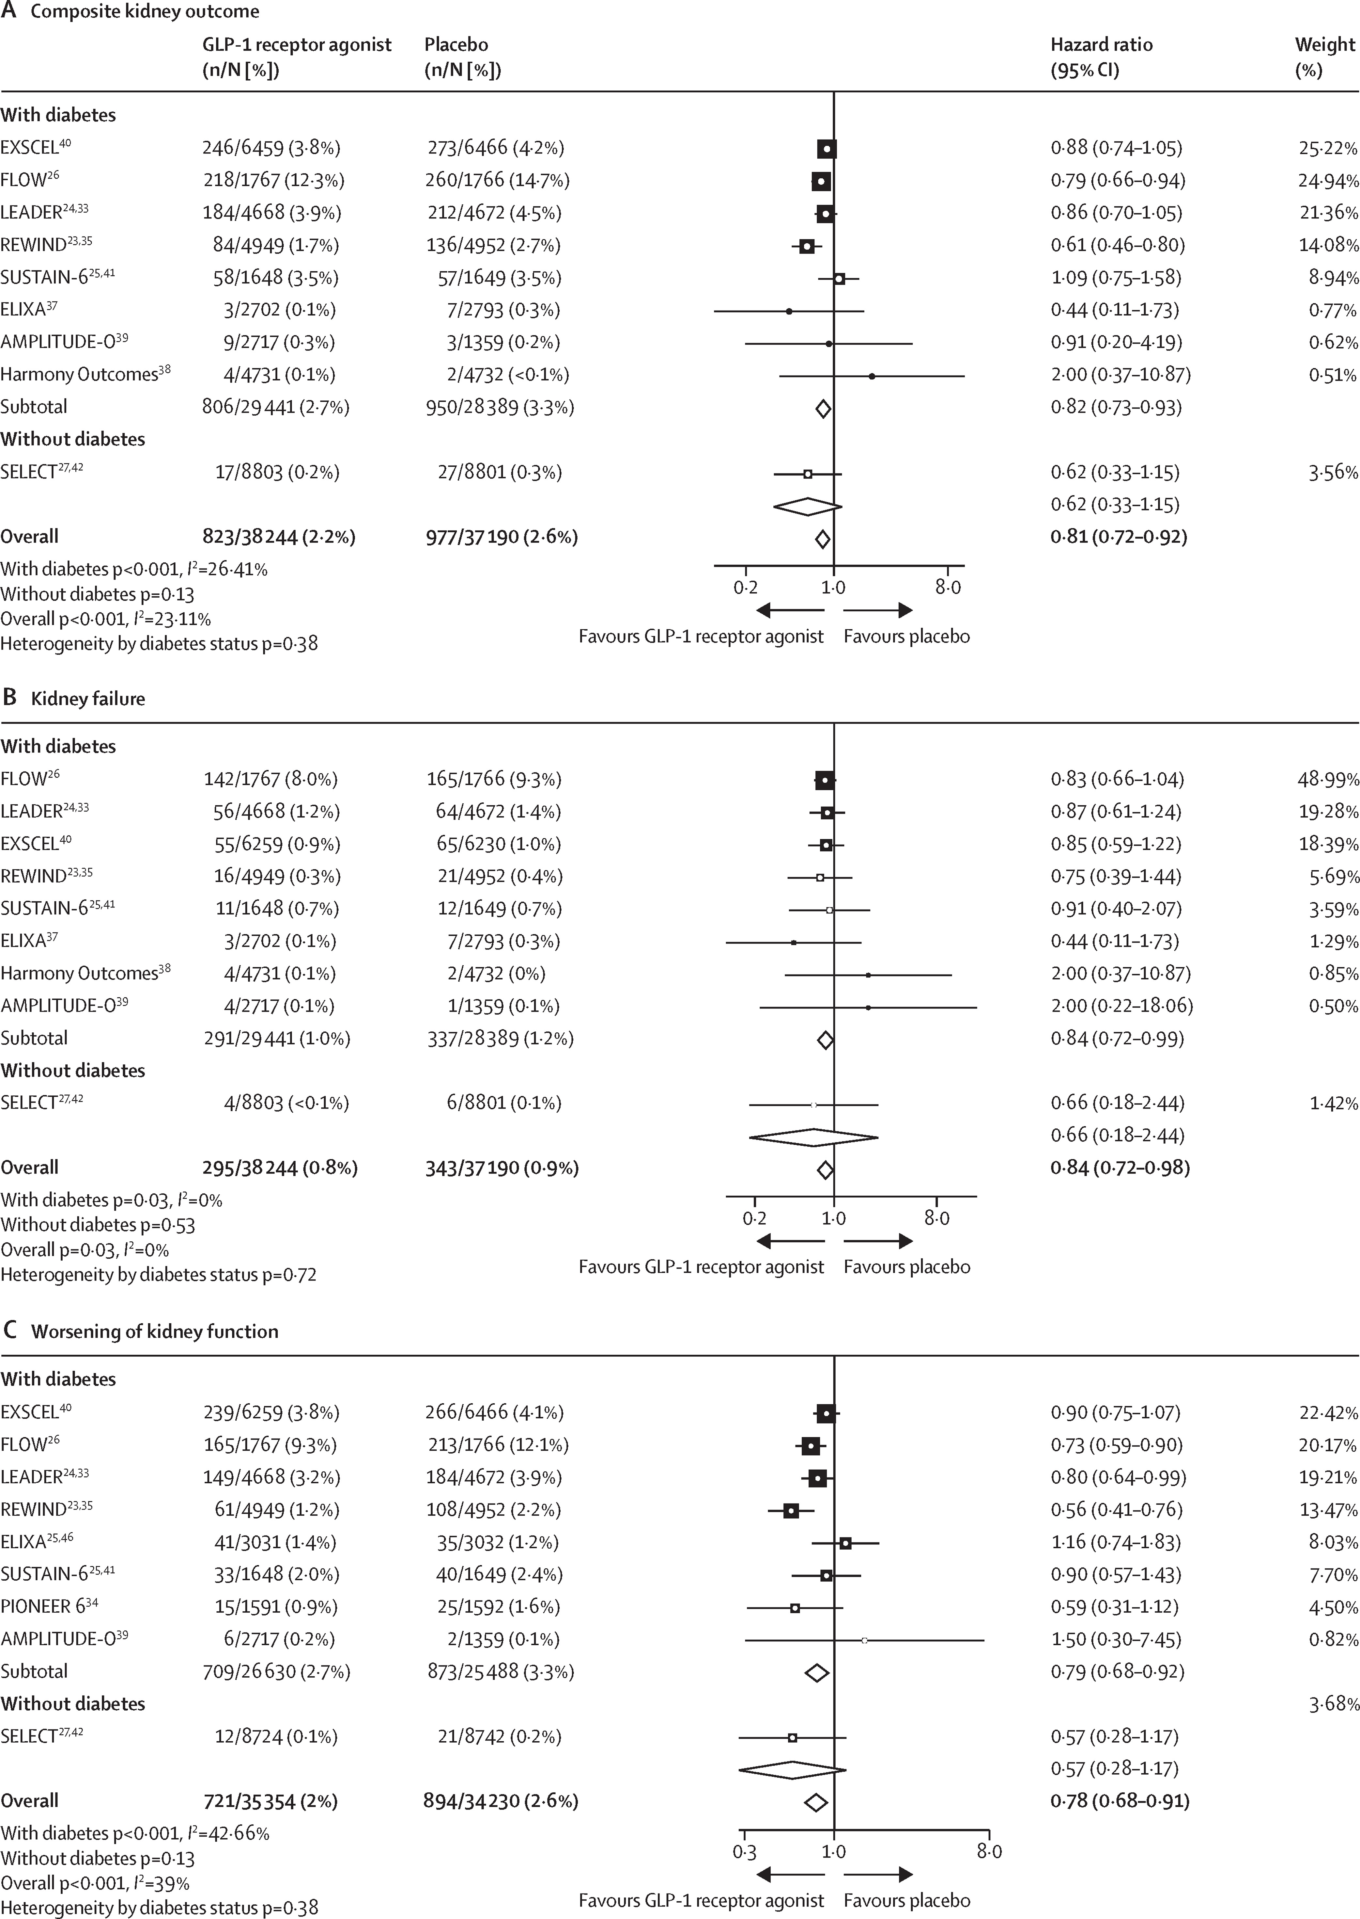

Slide 26
Conclusions
Obesity is a risk factor for ESKD and for renal transplant, as well as for graft loss
Substantial weight loss favourably impacts eligibility to kidney transplant
MBS in ESKD can be performed with (relative) safety
OMM show promising results, but long-term results are lacking, and are possibly not suitable for all patients
Probably best MBS first, then transplant
SG probably more adequate than RYGB

Slide 27
Thank you for your attention!
​ ​ francesco.papadia@unige.it

Slide 28
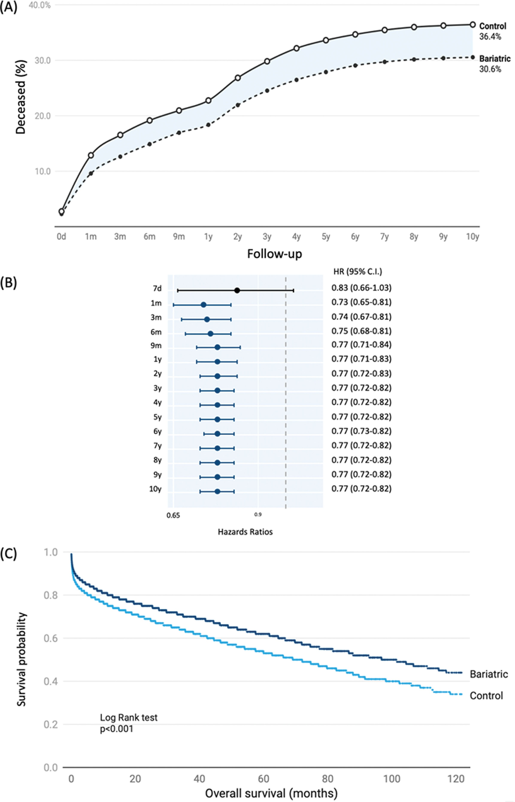
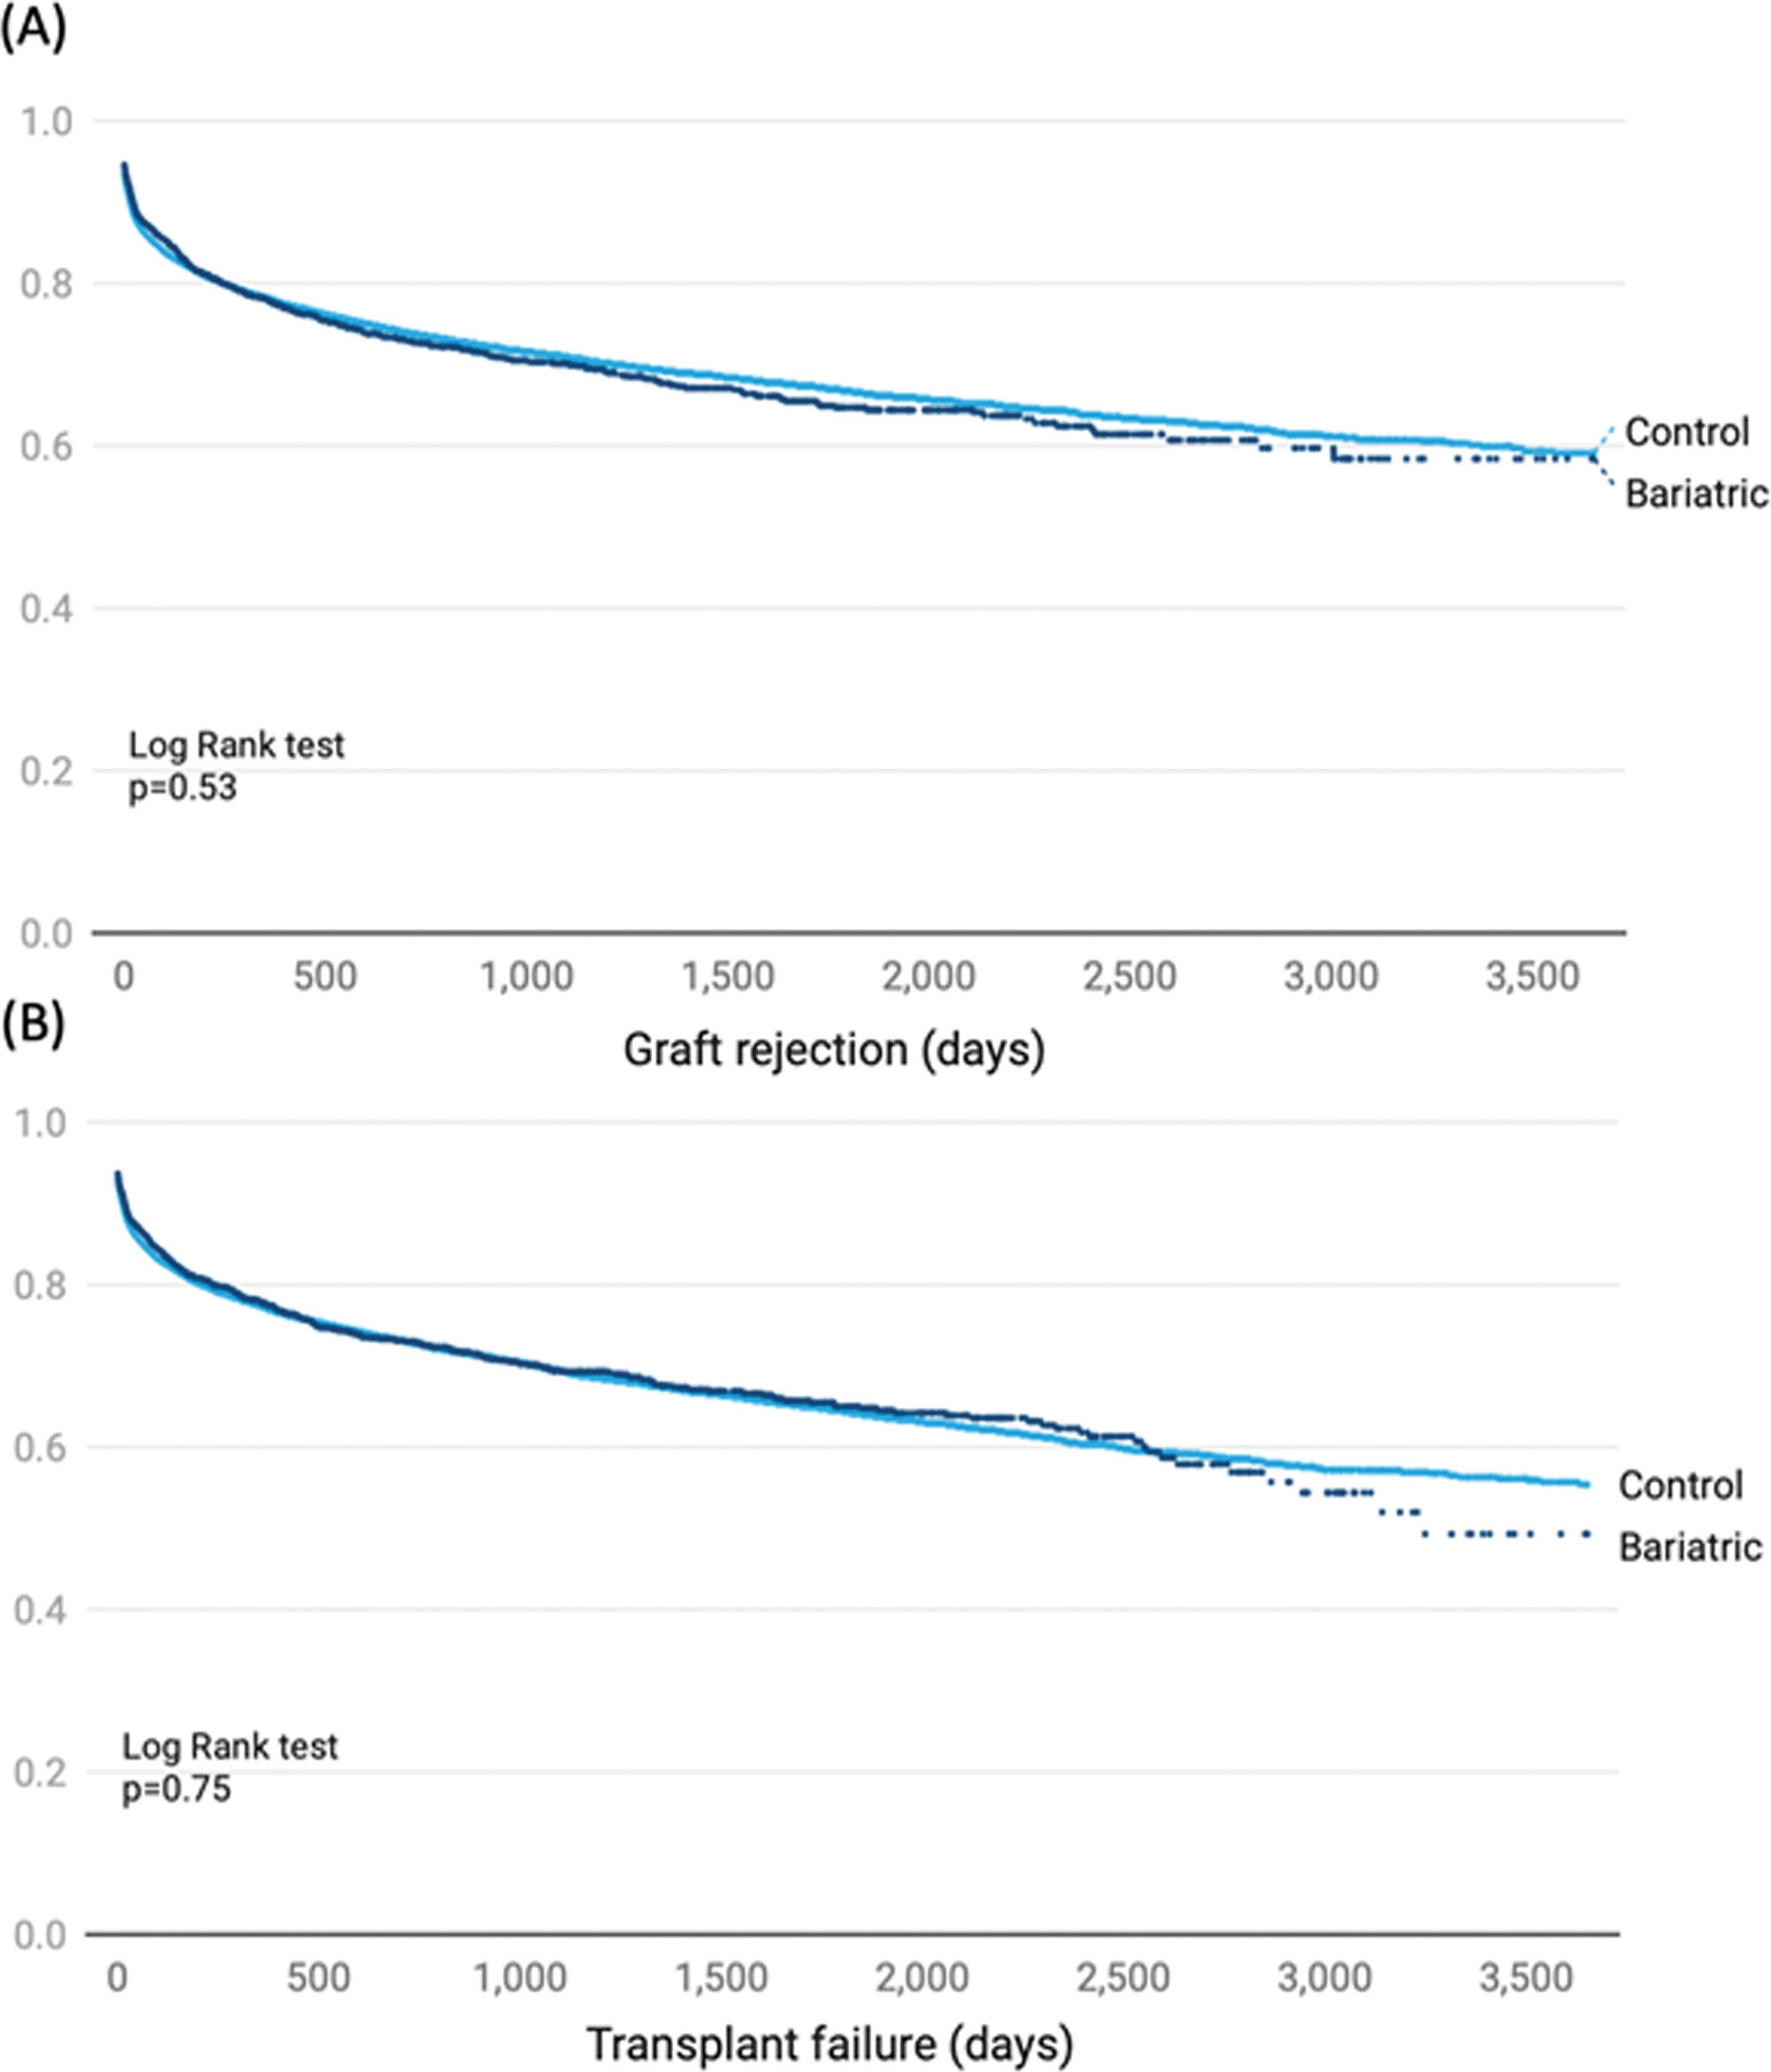

Slide 29
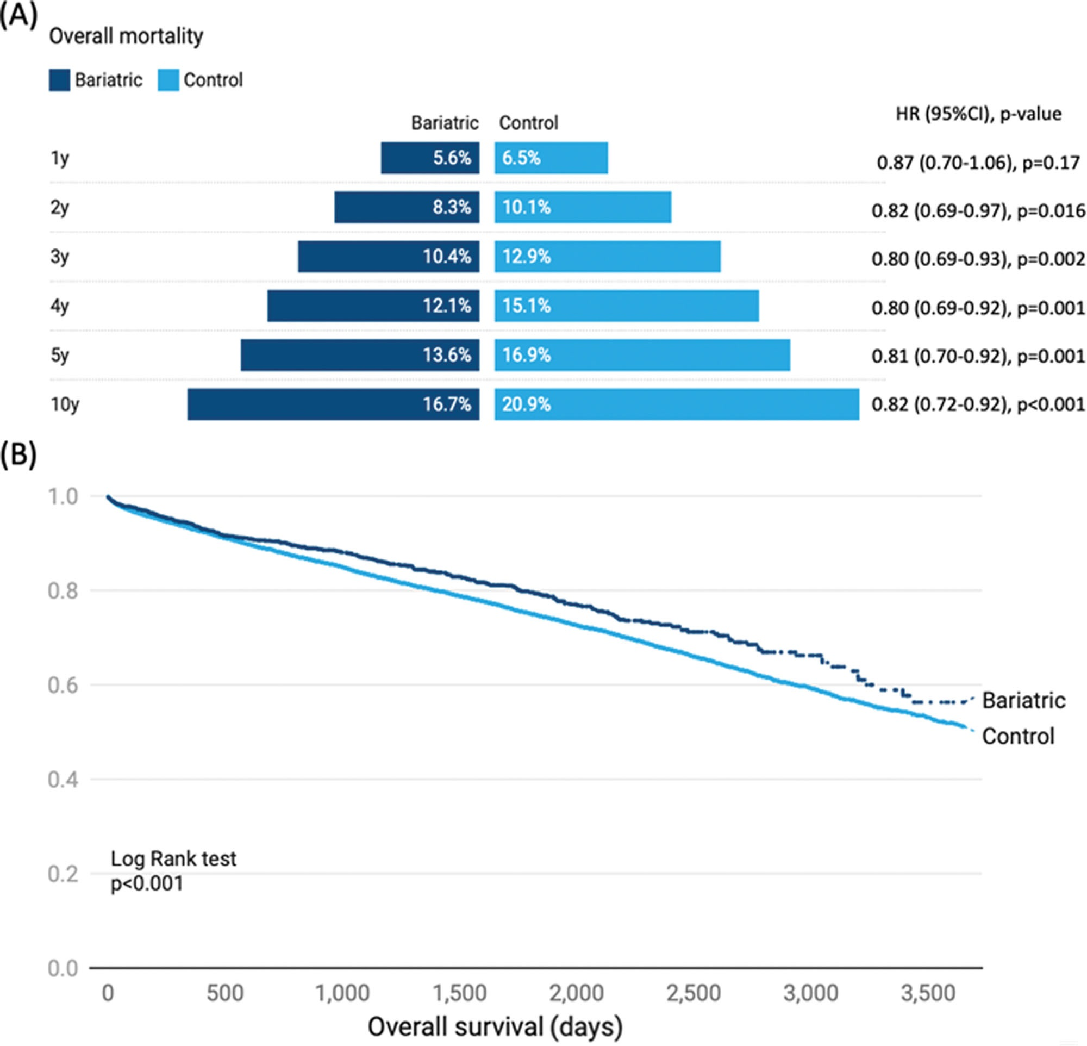

Slide 30


